Slide 1




Slide 2
SELECTING A TEST TOOL
Selecting the test tool is an important aspect of test automation for several reasons as given below.
Free tools are not well supported and get phased out soon.
Developing in-house tools takes time.
Test tools sold by vendors are expensive.
Test tools require strong training.
Test tools generally do not meet all the requirements for automation.
Not all test tools run on all platforms.
SOFTWARE TEST AUTOMATION

Slide 3
CRITERIA FOR SELECTING TEST TOOLS
Meeting requirements;
Technology expectations;
Training/skills;
Management aspects.
SOFTWARE TEST AUTOMATION

Slide 4
MEETING REQUIREMENTS
There are plenty of tools available in the market but rarely do they meet All the requirements of a given product or a given organization.
Evaluating different tools for different requirements involves significant effort, money, and time. Given of the plethora of choice available, huge delay is involved in selecting and implanting test tools.
Test tools are usually one generation behind and may not provide backward or forward compatibility (for example, java sdk support) with the product under test.
A number of test tools cannot differentiate between a product failure and a test failure.
SOFTWARE TEST AUTOMATION

Slide 5
TECHNOLOGY EXPECTATIONS
Test tools in general may not allow test developers to Extend/modify the functionality of the framework.
So extending the functionality requires going back to the tool vendor and involves additional cost and effort.
A good number of test tools require their libraries to be linked with product binaries. When these libraries are linked with the source code of the product, it is called "instrumented code.“
Test tools are not 100% cross-platform.
SOFTWARE TEST AUTOMATION

Slide 6
TRAINING/SKILLS
While test tools require plenty of training, very few vendors provide the Training to the required level.
Organization-level training is needed to deploy the test tools, as the users of the test suite are not only the test team but also the development team and other areas like configuration management.
Test tools expect the users to learn new language/scripts and may not use standard languages/scripts.
This increases skill requirements for automation and increases the need for a learning curve inside the organization.
SOFTWARE TEST AUTOMATION

Slide 7
MANAGEMENT ASPECTS
A test tool increases the system requirement and requires the hardware and software to be upgraded. This increases the cost of the already-expensive test tool.
However, due to project pressures, test tools the effort at deploying gets diluted, not spent.
Later, thus becomes one of the reasons for delay or for automation not meeting expectations.
The support available on the tool is another important point to be considered while selecting and deploying the test tool.
SOFTWARE TEST AUTOMATION

Slide 8
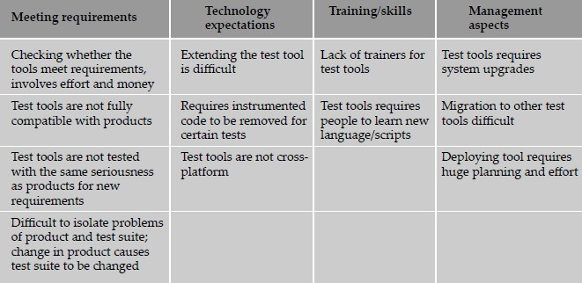
CRITERIA FOR SELECTING TEST TOOLS
SOFTWARE TEST AUTOMATION

Slide 9
STEPS FOR TOOL SELECTION AND DEPLOYMENT
Identify your test suite requirements among the generic requirements discussed. Add other requirements (if any).
Make sure experiences discussed in previous sections are taken care of.
Collect the experiences of other organizations which used similar test tools.
Keep a checklist of questions to be asked to the vendors on cost/effort/support.
Identify list of tools that meet the above requirements (give priority for the tool which is available with source code).
Evaluate and shortlist one/set of tools and train all test developers on the tool.
Deploy the tool across test teams after training all potential users of the tool
SOFTWARE TEST AUTOMATION

Slide 10
CHALLENGES IN AUTOMATION
The most important of these challenges is management commitment
Automation takes time and effort and pays off in the long run. However, automation requires significant initial outlay of money as well as a steep learning curve for the test engineers before it can start paying off.
The main challenge here is because of the heavy front-loading of costs of test automation, management starts to look for an early payback.
SOFTWARE TEST AUTOMATION

Slide 11
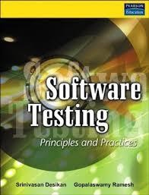



REFERENCES
SOFTWARE TEST AUTOMATION

